Slide 1

Feed Bins & Dosing
Technical Development Program for PPE, 2014-2015

Slide 2
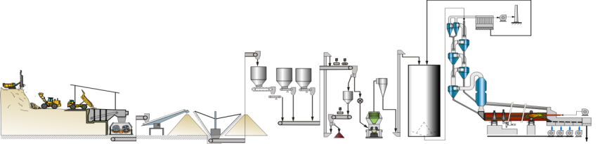
Process Integration
Provide stable mass flow for the raw mill
Optimal energy utilisation
Maximum availability & reliability
Achieve the right mix
Chemical targets
Homogeneity
Buffer storage after reclaiming
2

Slide 3
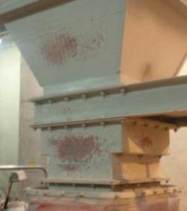
Importance of Feed Bins & Dosing
Feed bin problems are a major cause for mill problems (damages, low production rate, gearbox failures)!
Segregation
Erratic flow
Blockages
A process chain is only as strong as its weakest link
3

Slide 4
Feed Bins & Dosing
Feed Bins
4

Slide 5
Wrong Feed Bin Design
Various problems are a result of bad feed bin design
Incomplete emptying and reduced bin live capacity
Inconsistent material reclaim rate
Varying product quality and loss of production
Need for dangerous manual cleaning action
5

Slide 6
Correct Feed Bin Design
Always design feed bins for mass flow
To achieve this, a feed bin has to be designed according to the material properties, which depend on:
Particle size distribution
Moisture content
Chemical composition
Particle shape
Temperature
and other parameters…
X
Funnel flow
Mass flow
6

Slide 7
Correct Feed Bin Design
The main properties for feed bin design are:
Abrasiveness
Flowability
Determined by shear tests
Flowability generally decreases with increasing fines and moisture
7

Slide 8
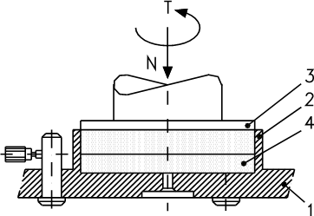
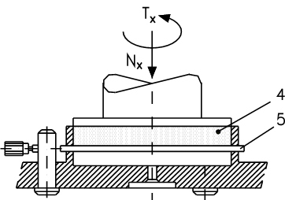
Correct Bin Design – Shear Test
Internal friction
Describes tendency to bridge and thus define the required minimum bin outlet dimensions
External friction
Describes tendency to stick and thus define the required minimum wall inclinations and suitable internal wall lining material
1 : Base ring
2 : Upper ring
3 : Cover
4 : Sample of bulk solid
5: Sample of wall material
Shear plane
N/Nx: Normal compressive
load
T/Tx: Shear torque
8

Slide 9
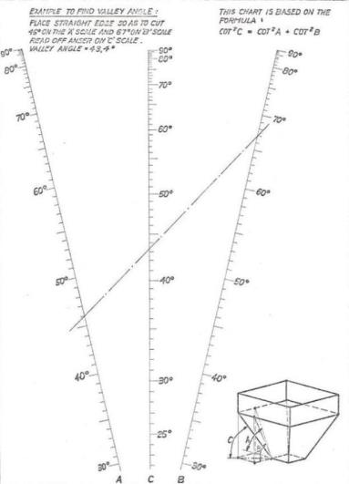

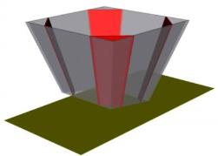
Wall Inclination
Valley angle
The common inclination formed by two inclined planes is the lowest inclination!
Rounded corners reduce the risk of sticking material
9

Slide 10
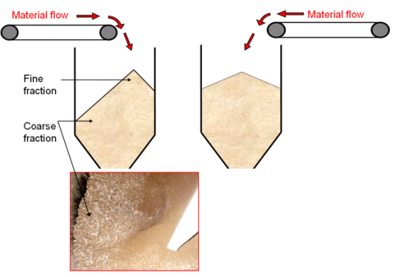
Segregation
Segregation cannot be avoided when feeding a bin
It is normally compensated in mass flow bins
Eccentric feeding points can cause excessive segregation and thus affect product uniformity
Relocate feed point to the centre
10

Slide 11
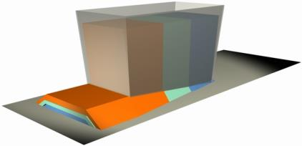
Feed Bin Outlets
Expanding design for full outlet activation
Bin outlet activation if required
Oscillating feeder
Discharge arm
Rotating screw
Discharge aids only as corrective measure and carefully used. Danger of further compaction!
Aeration
Vibration
11

Slide 12
Feed Bins & Dosing
Dosing
12

Slide 13
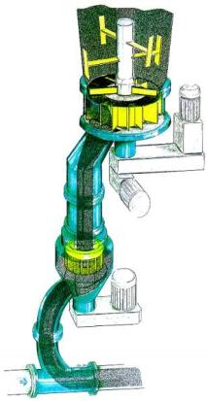
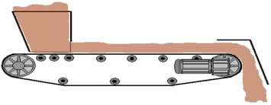
Theory of Dosing
Dosing = Feeding + Measuring + Control
Use gravimetric feed systems
Repeatability
Accuracy
Know the relevant time basis to assess dosing performance
For raw mill feed: approx. 10min (depending on mill)
Feeding
Control
Measuring
13

Slide 14
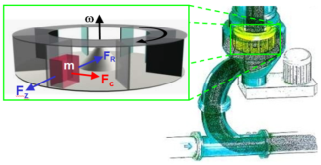
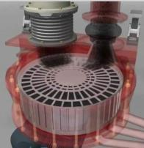
Flow Measurement for Fine Materials
Impact flow meter (not recommended)
Coriolis flow meter (Schenck Process®)
Rotor scale with integrated feeder (Pfister®)
14

Slide 15
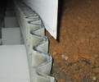

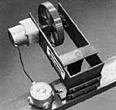
Belt Weigh Feeder - Maintenance
Constant belt tension
Proper belt alignment
Clean and functioning tensioning station
Constant belt stiffness
No metal splice
No skirted belt
No belt damages / patches
Reliable and clean belt speed sensor
On a 100mm diameter wheel, coating of 0.5mm results in
a weighing error of 1% !
No material build-ups, spillage or equipment on weighing mechanism
15

Slide 16
Targets
Targets for belt weigh feeders
Turndown ratio min. 10:1
Long term accuracy better than +/- 0.5%
Short term accuracy better than +/- 1.0%
Response to set point changes < 10 % shall be less than 1 min.
Achieve these targets through
Maintaining your equipment in a clean condition
Calibration (and documentation)
On regular basis
After changes on equipment or material
When readings are suspicious
16

Slide 17
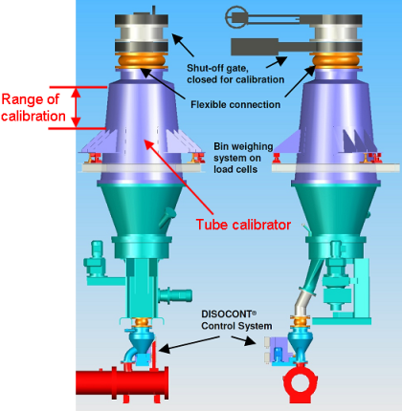
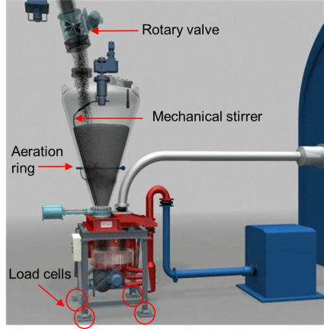
Online Calibration (loss-in-weight)
Coriolis flow meter → with tube calibrator
Rotor weigh feeder → with pre-bin
17

Slide 18




Offline Calibration
Belt weigh feeder calibration by:
Test weight method
Volumetric measurement
Loss-in-weight method
Drop test (load on truck)
Details on calibration methods
18

